Slide 1
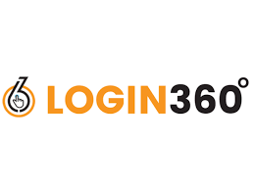
Personal Expense Tracker using Python
Abinesh .M
Python Fullstack Development

Slide 2
OBJECTIVE
To develop a simple Python program that tracks daily income and expenses and displays balance reports for better money management.
This project helps to record income and expenses using Python. It shows daily and monthly reports to manage money easily.

Slide 3
INTRODUCTION
This project is a Python console application.
It helps users record income and expenses.
It also shows daily and monthly reports.
The goal is to help users manage money easily.

Slide 4
Tools & Concepts Used
Programming Language, Editor : Python, Visual studio code
Module Used: date time (for date tracking)
Concepts:
Variables and Loops
Lists and Dictionaries
Conditional Statements (if-else
Basic Arithmetic Operations

Slide 5
Working Process
1. User selects from a menu (Add Income, Add Expense, etc.)
2. Program stores data in a list of transactions.
3. Each transaction includes:
Type (income/expense)
Amount
Category
Date
4. User can view:
Total balance
Daily report
Monthly report

Slide 6
Features
Easy to use (menu-driven)
Shows daily and monthly summaries
Tracks balance automatically
Helps improve financial awareness.

Slide 7
Future Improvements
Save all data permanently in a file or database.
Add graphs or charts to show spending visually.
Create a login system for multiple users.
Build a mobile or web version using a GUI

Slide 8
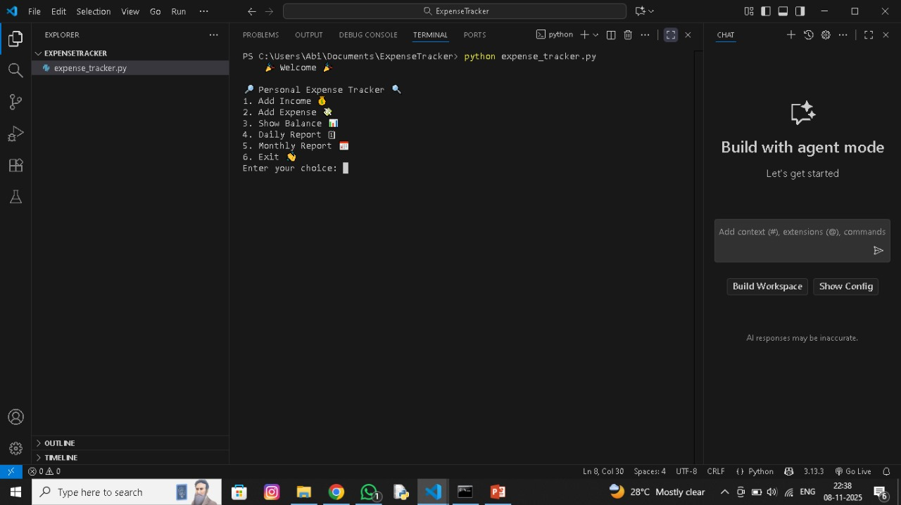
OUTPUT

Slide 9
🌟 Conclusion
This project makes money tracking simple and fun. It helps record income and expenses quickly using Python and shows clear reports for better savings.

Slide 10
THANK YOU

